Slide 1
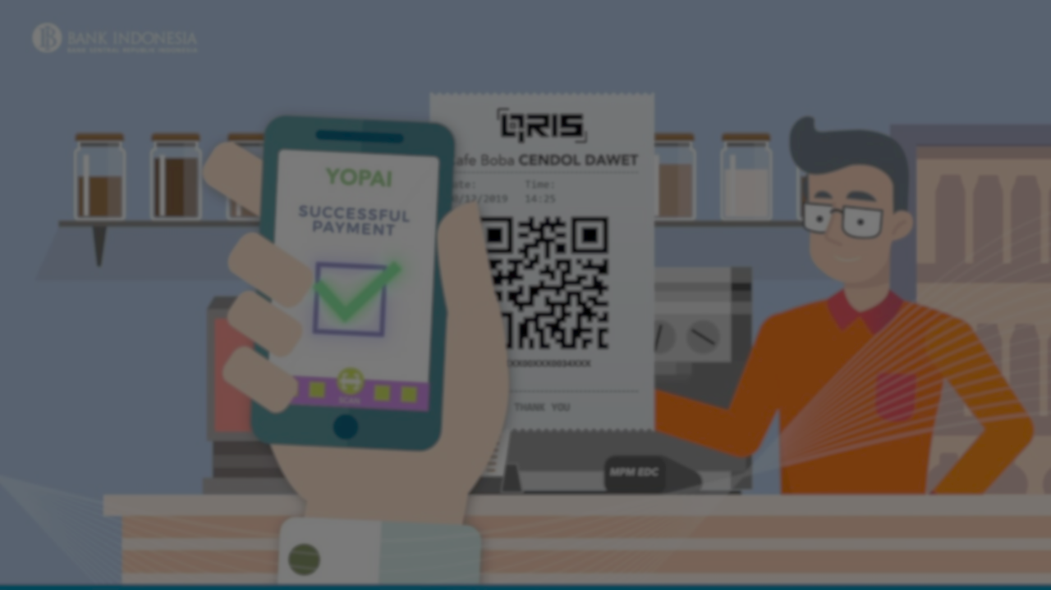


Mobile Wallet for Money Payments and Money Transfer

Slide 2

Under Supervision of
DR: Hamada Nayel

Slide 3
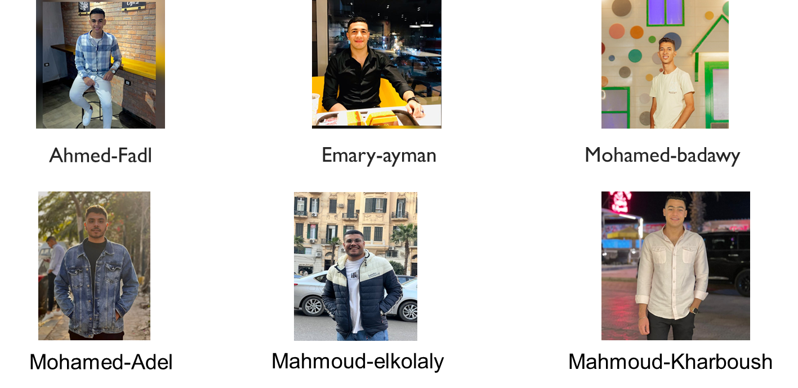
OUR TEAM

Slide 4
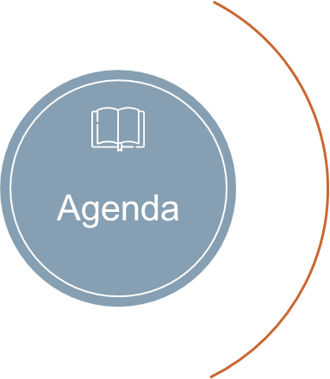
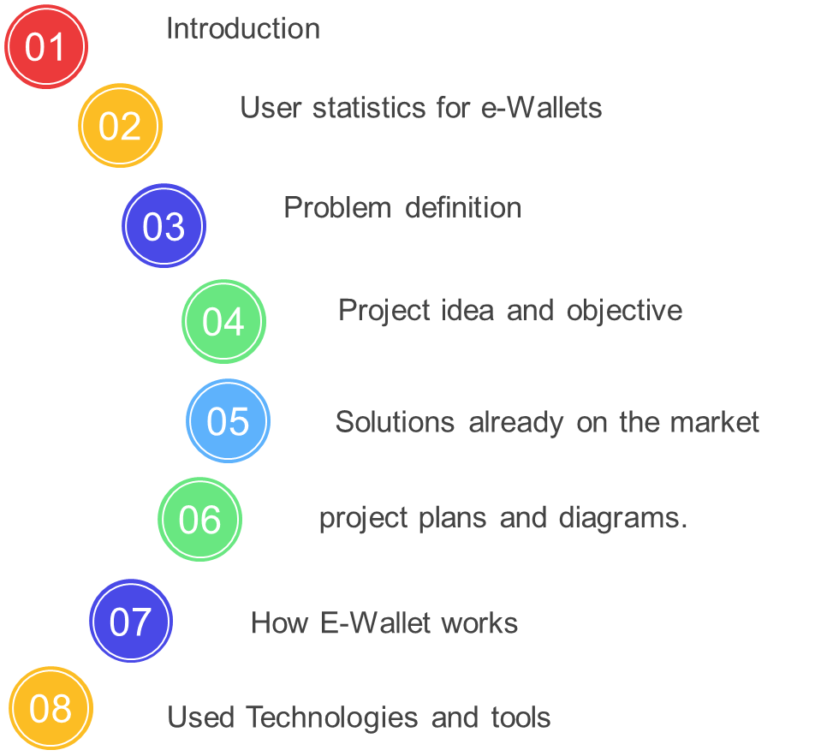

Slide 5
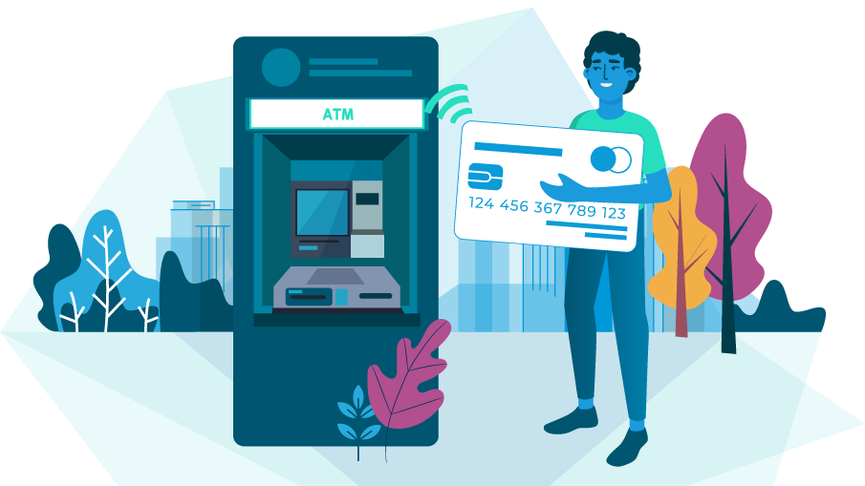
Introduction

Slide 6
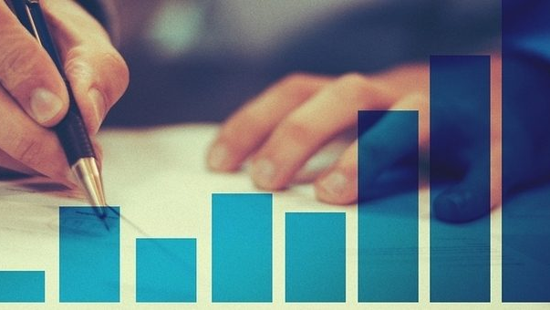
We found the following:
In the beginning, we did a statistical survey of the number of people who use electronic payment processes and purchase products via the Internet.

Slide 7
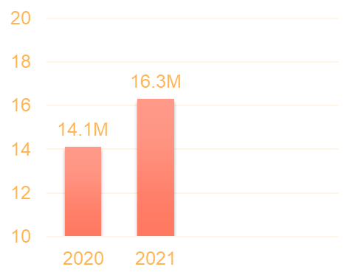
Some statistics for digital transformations
A study was reported by the Russian Research Center Kaspersky
The number of e-wallets increased by 16%
Reaching 16.3 million e-wallets in the first half of 2021 compared to 14.1 million e-wallets in the first half of 2020.

Slide 8
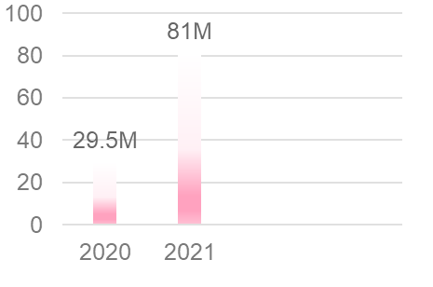
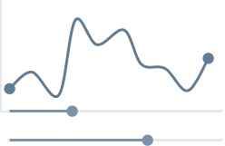
Some statistics for digital transformations
The number of electronic transactions carried out using wallets increased by 175%, reaching 81 million electronic transactions in the first half of 2021, compared to 29.5 million electronic transactions in the first half of 2020.

Slide 9

Problem definition

Slide 10
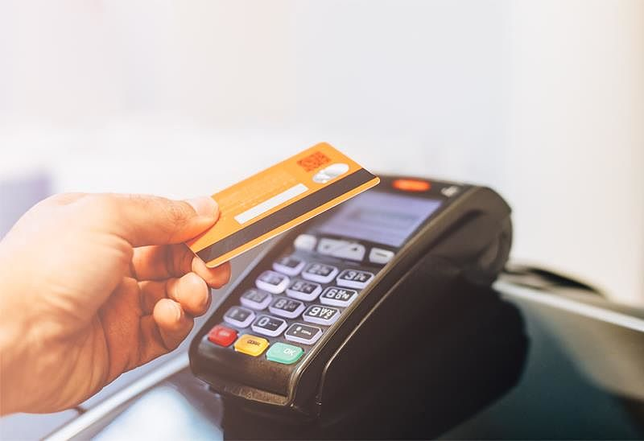

Cash-Receiving device
The merchant's inability to purchase a cash-receiving device to support the Visa card
Online stores
The late arrival of funds in the online purchase process.
Not most online stores have a smooth method of payment and receive.

Slide 11

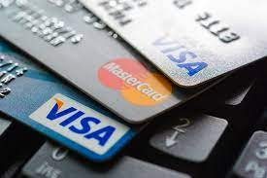
family expenses
Ease of providing children with the amounts that can be used.
Bank account
Each bank account has one card usable by one person only.

Slide 12

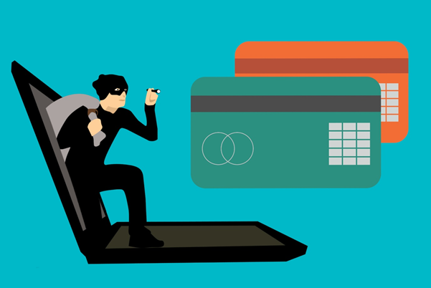
Distrust
There is no trust between the customer and the merchant
Theft of card data )NFC)
Theft of card data using wireless in Visa card.

Slide 13
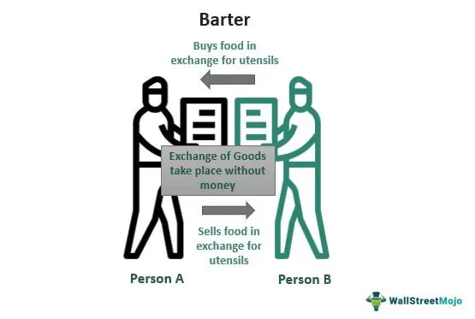
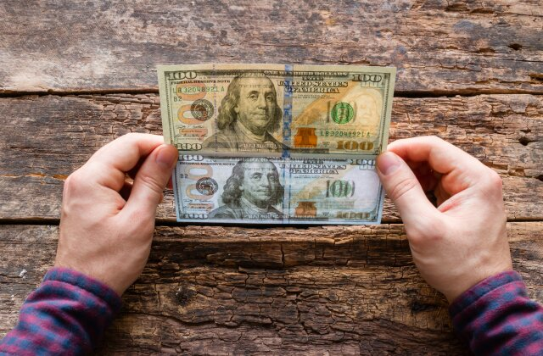
interaction between people
Interaction between people with paper money increases the spread of diseases in the event of a virus such as the Corona virus.
Forgery money
The spread of counterfeit money between people and merchants, so it causes a lack of trust between people and each other.

Slide 14

Project idea and objectives

Slide 15

Introduction
Just mobile app integrated with payment gateway to swap money between users, this application support Android and iOS platform and the main objective of this application is
facility the payment transaction in the commercial aspect
Achieving the principle of financial inclusion
What is financial inclusion ?

Slide 16
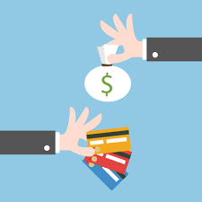

Financial Inclusion
Any induvial or institution has access to useful , suitable , affordable financial service and products that meet their needs This service can be 1- deposit 2- Loan 3- Insurance 4- Swapping money

Slide 17
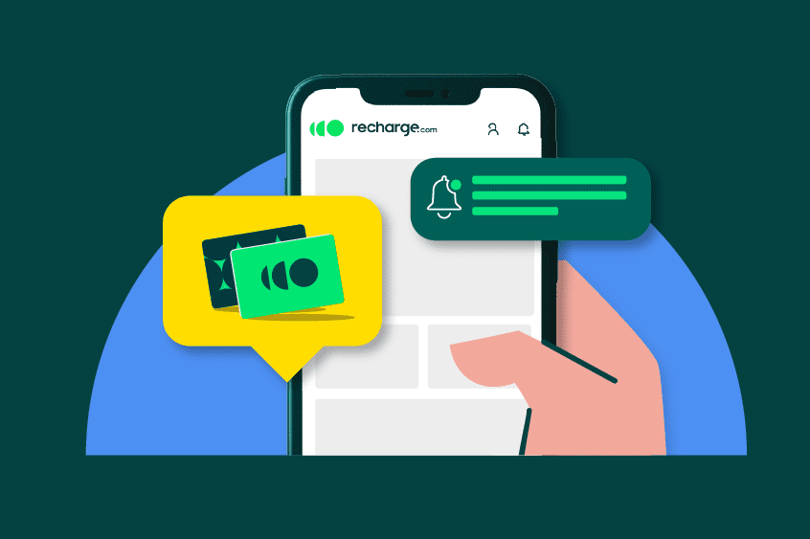
Recharge and Withdraw
To recharge or withdraw balance to or from e-wallet you used 3 methods
Bank cards [ Visa , Mastercard ]
Mobile wallet [Vodafone Cash, We Pay, Orange Pay ]
Aman , Masary , Fawry
Our wallet is integrated with payment gateway to make as intermediator between this methods and our wallet
What is payment getaway ?

Slide 18
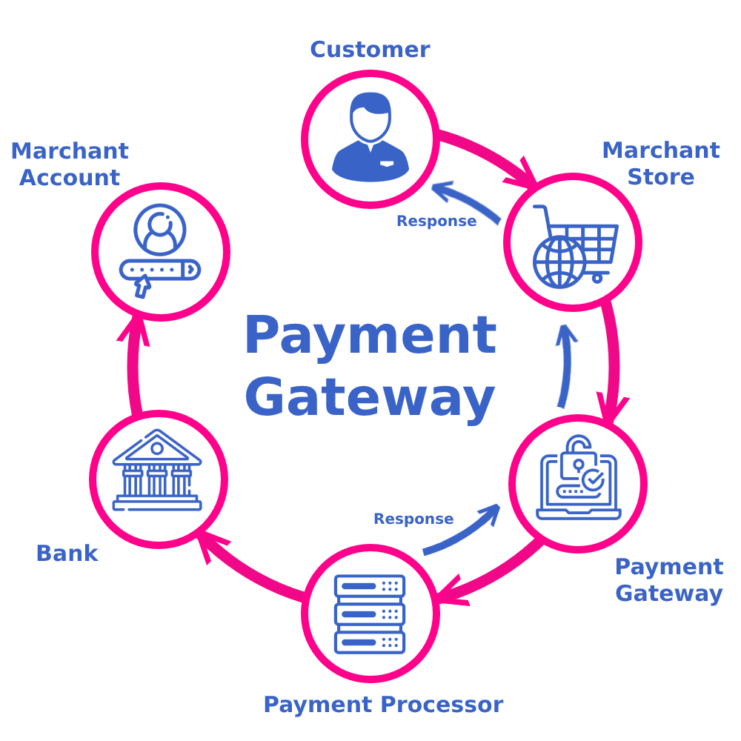
Payment getaway

Slide 19
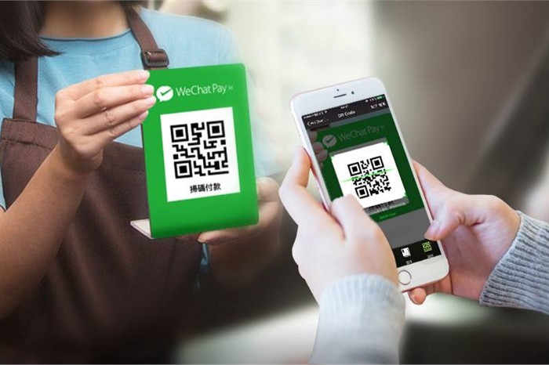
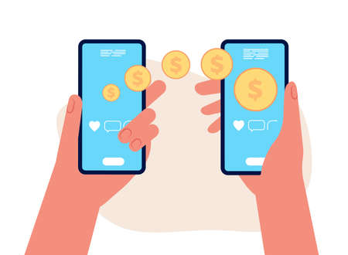
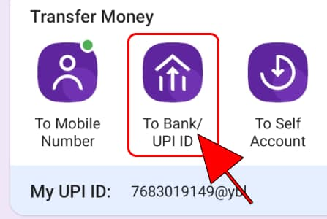
Swapping money
our application will digitize the process of swapping money between users by use any of this money
1. Scan QR code to Pay
2. Use Id To Transfer
3. Use link To Transfer

Slide 20
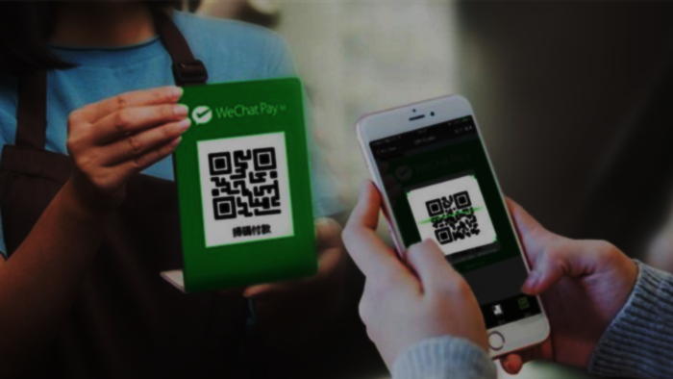
Scan To move money :
It just a simple QR code or ID used when transfer money between users either user make cash in our cash out

Slide 21
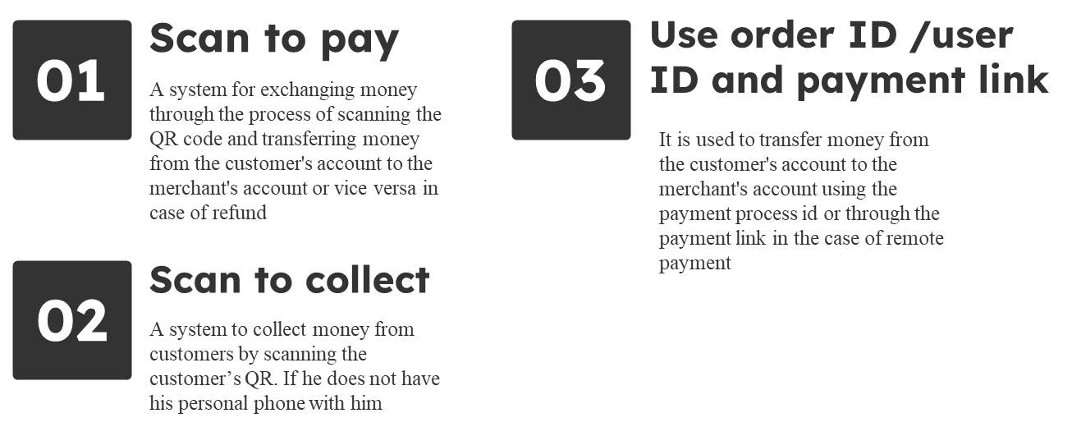
Scan To move money :

Slide 22
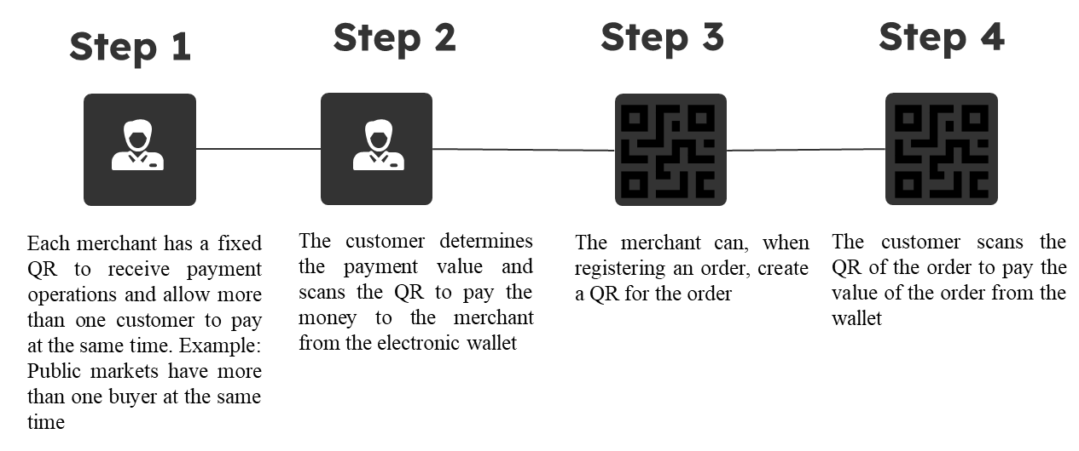
Scan to pay

Slide 23
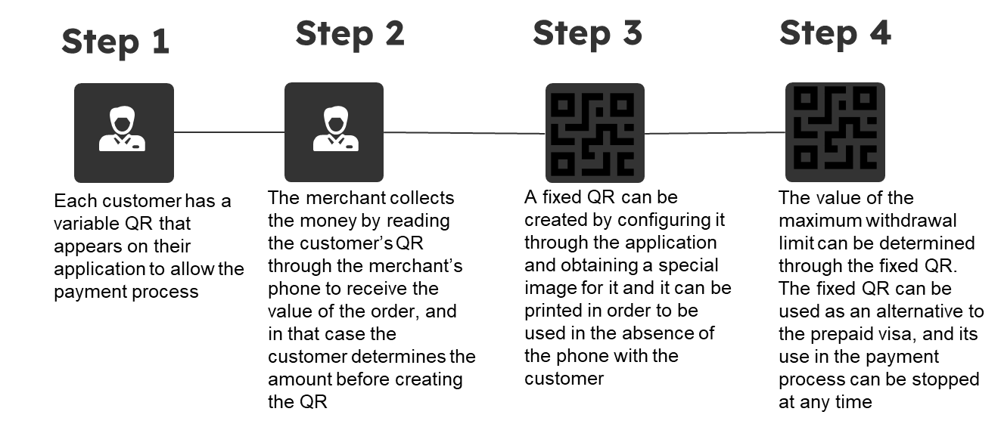
Scan to collect

Slide 24
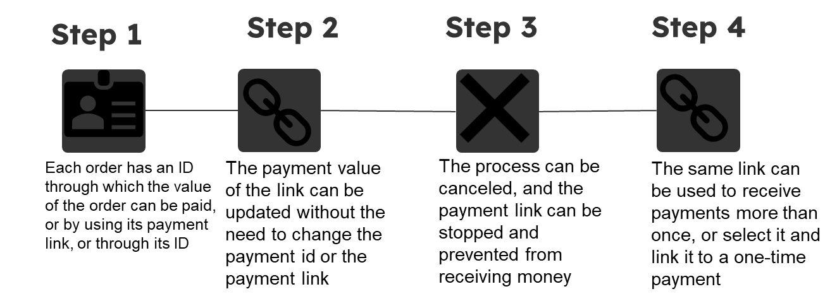
Use id to transfer

Slide 25
Benefits of e-wallet

Slide 26

Solutions already on the market

Slide 27

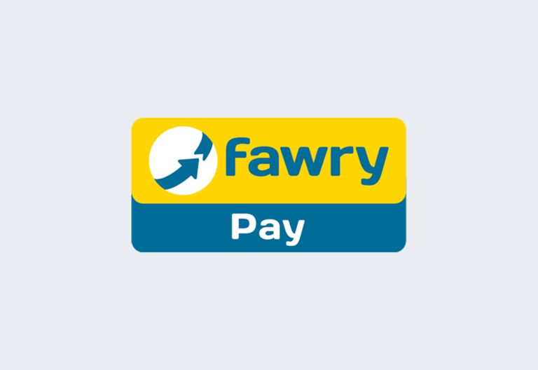
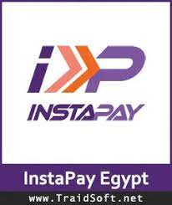

Some of the Companies in the market
Fawry –pay
lucky
Instapay
Vodafone cash

Slide 28
Problems of these programs with users
Vodafone cash
lucky
Increase Vodafone Cash withdrawal fees
Service stopped at some Vodafone branches
Weak network signal while using Vodafone Cash
Vodafone Cash stopped working during use
Increase withdrawal fees
Dealing in foreign currencies, which increases the commission rate on transfers
Fawry –pay
Instapay
E-wallets cannot be linked to it
The youth account under 21 years old is not supported
E-wallets cannot be linked to it
High commission

Slide 29

our-solution-to solve this problem…..

Slide 30
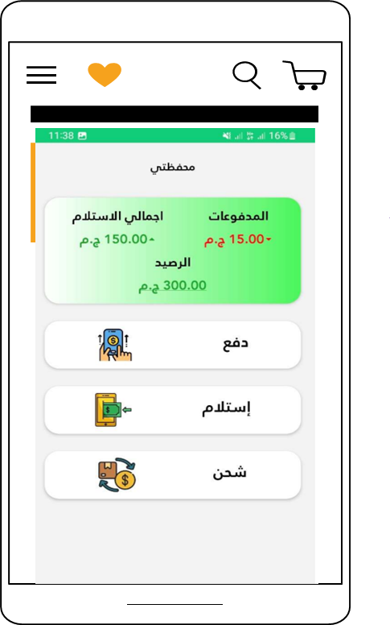
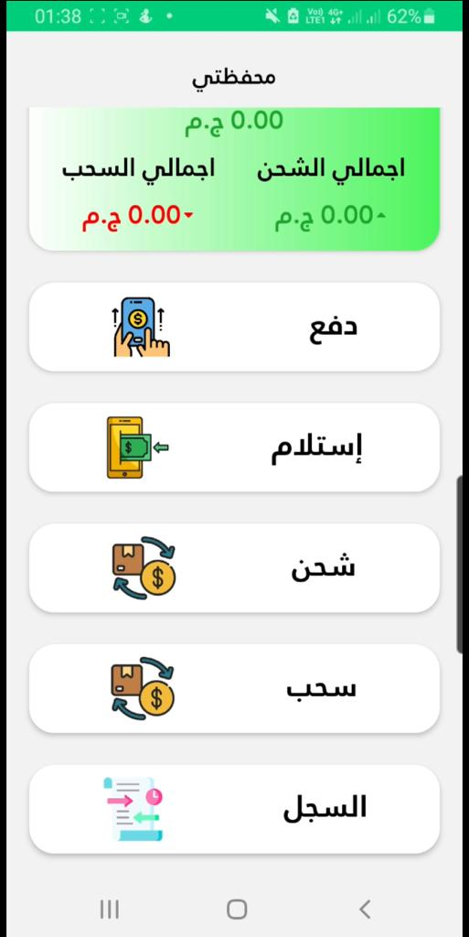
In our project We tried as much as possible to solve the problems in the other applications that we mentioned, and we estimated that we put some solutions such as
Reduce additional fees on transactions
Increase the percentage of withdrawal and deposit during one time or month
Not to rely on one telecommunications company, so the user can activate his account with any mobile number (multiple telecommunications companies
You can easily pay through a QR code
You can easily activate the QR code with the value you want and set a period for the expiration of this code
Not being tied to a specific bank account
Not linking to a specific place in order to activate your account
Easy activation of your account through your mobile phone and personal number whatever your network type

Slide 31

Used Technologies and tools

Slide 32



Technologies and tools (in front end)
1-React native
3- Css3
2- java script

Slide 33

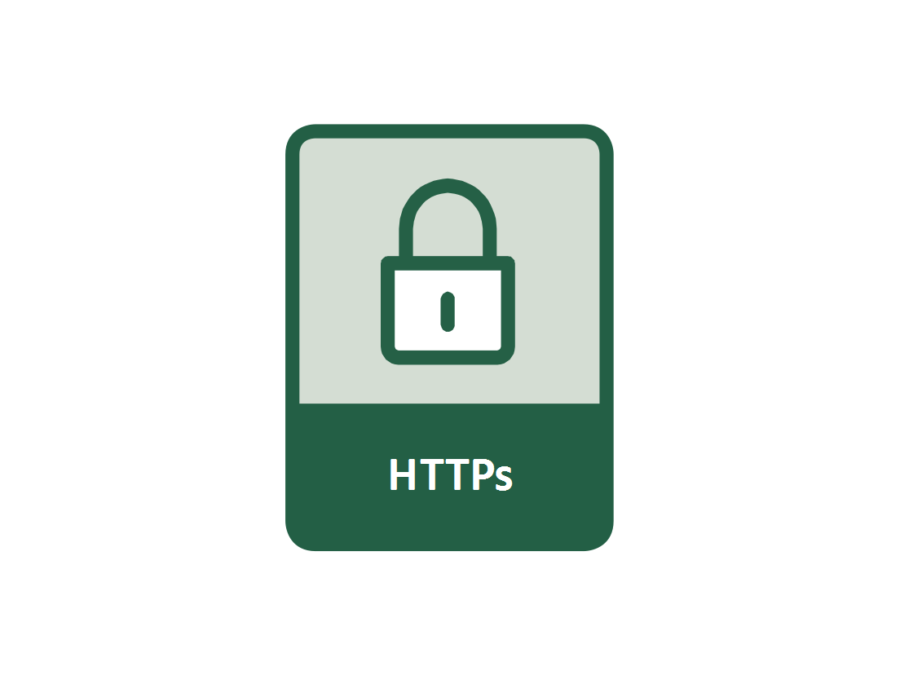

Technologies and tools (in back end)
4- PHP
6-HTTPs protocol
5-MySQL

Slide 34

Methodology

Slide 35

AES-128-CTR
. Utilizes 128-bit key size
. Strong and widely adopted
. Efficient encryption and decryption
. VPN protocols

Slide 36
Sha-256
High level of security.
Used to Password storage
Data integrity verification

Slide 37
E-Wallet mobile application

Slide 38
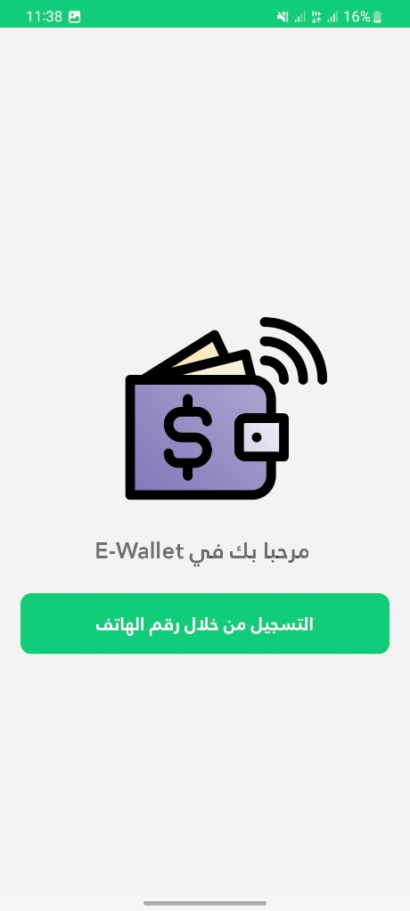
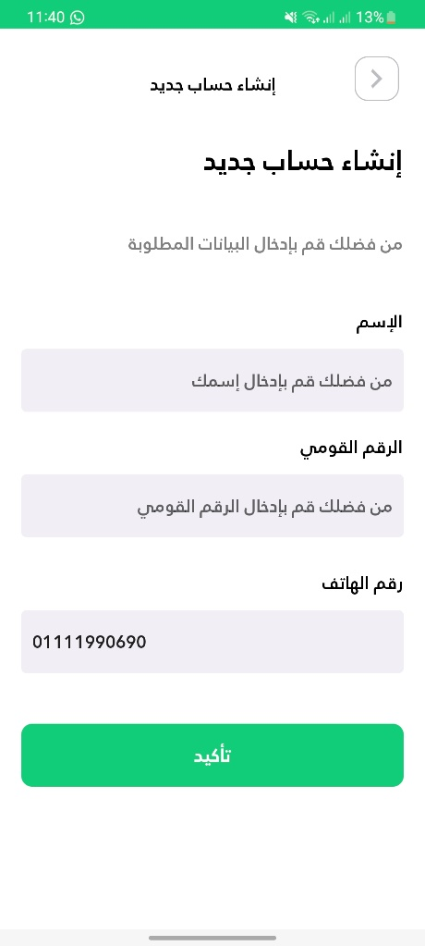
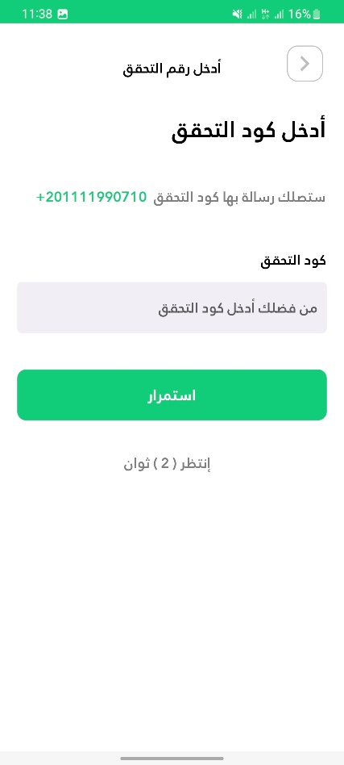
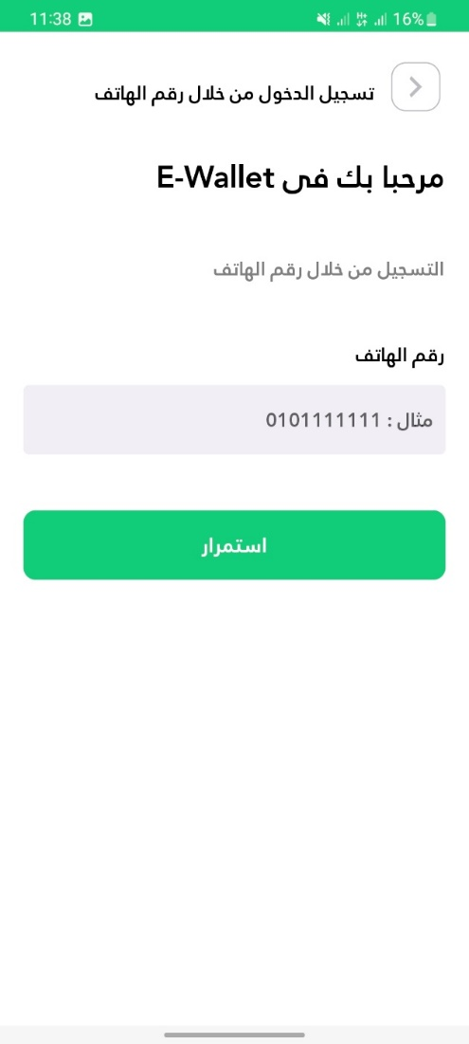
1
REGISTRATION….
User registers his wallet and set the PIN-code for quick and easy login

Slide 39
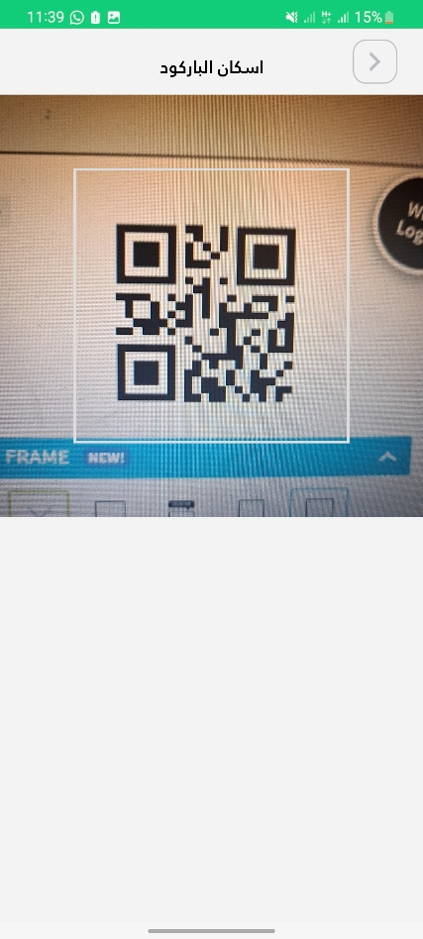
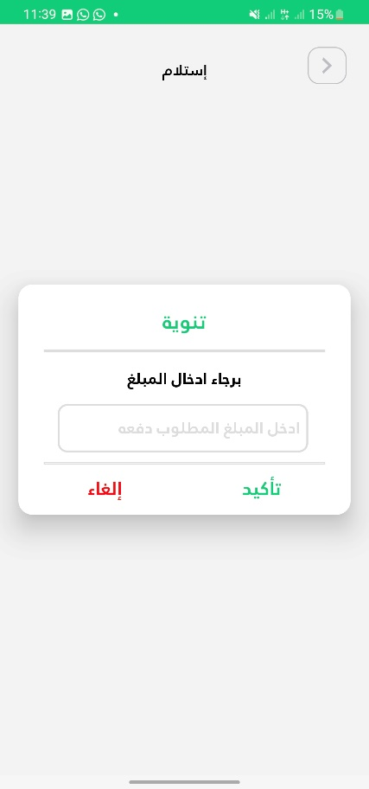
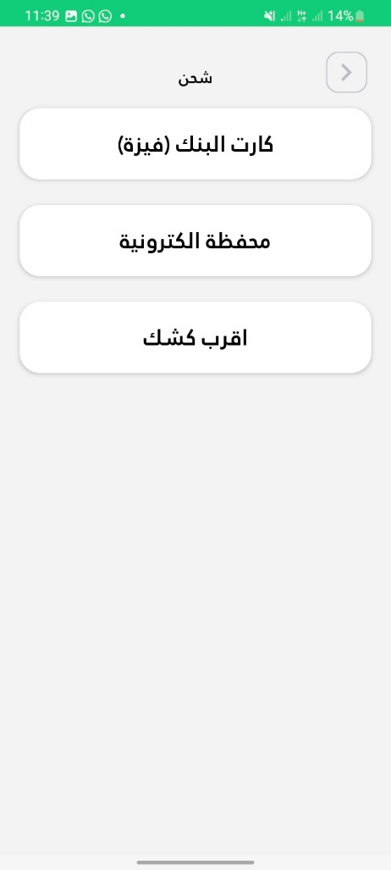
2
Main Menu ….
That include Payment, receipt and charge of money

Slide 40
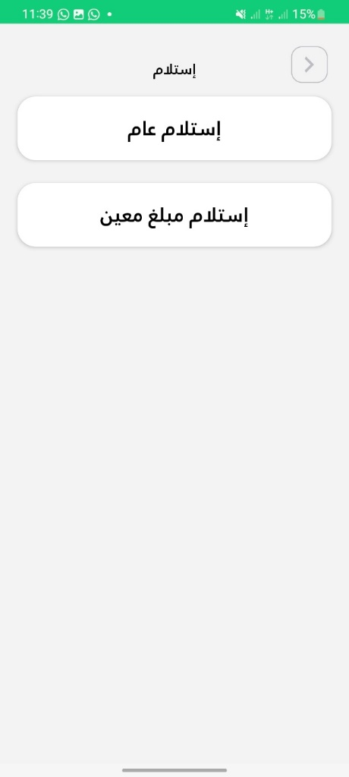
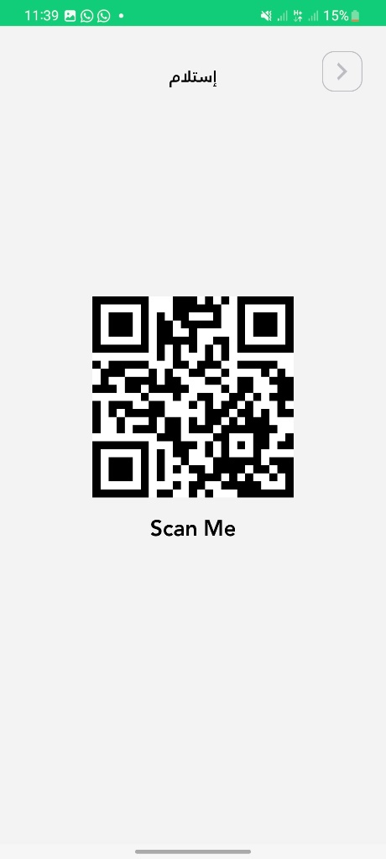
3
receipt money….
You can receipt money using two way (using QR-code) :
General
specified amount

Slide 41
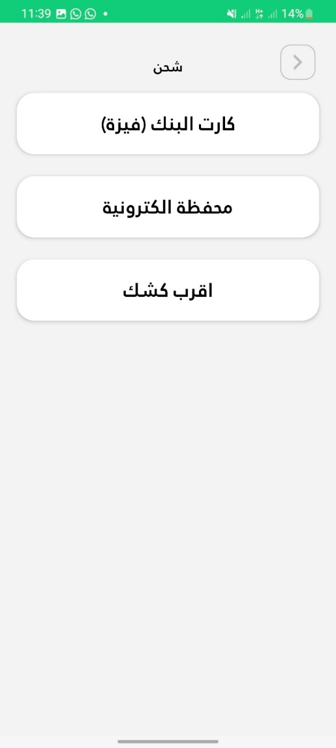
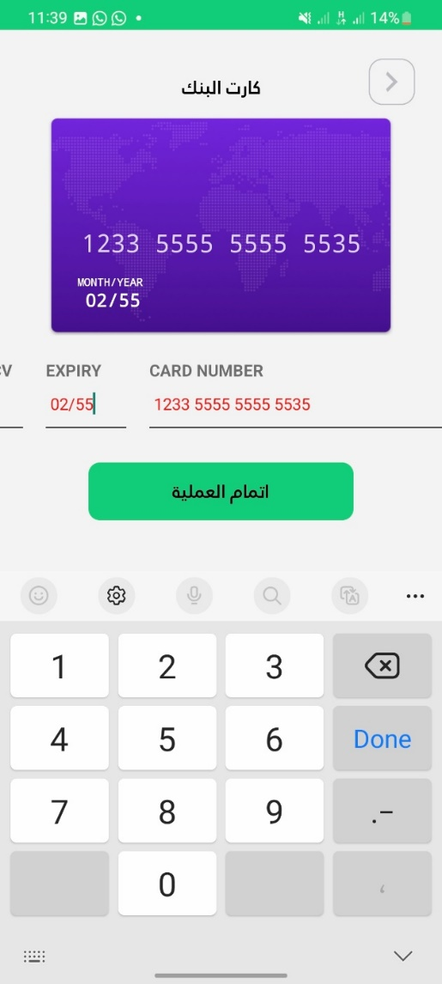
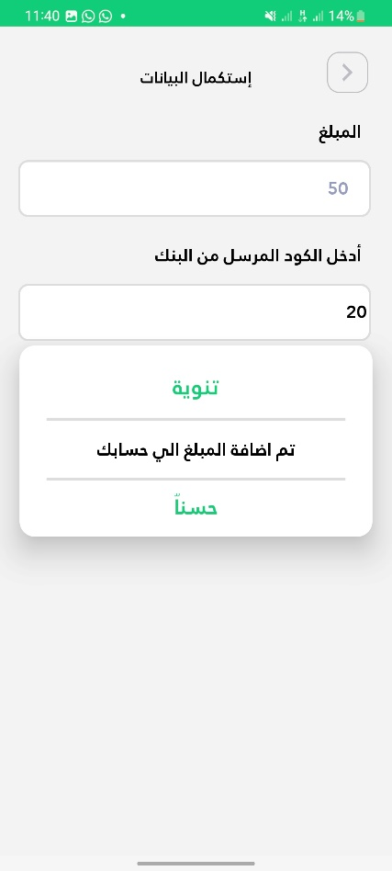
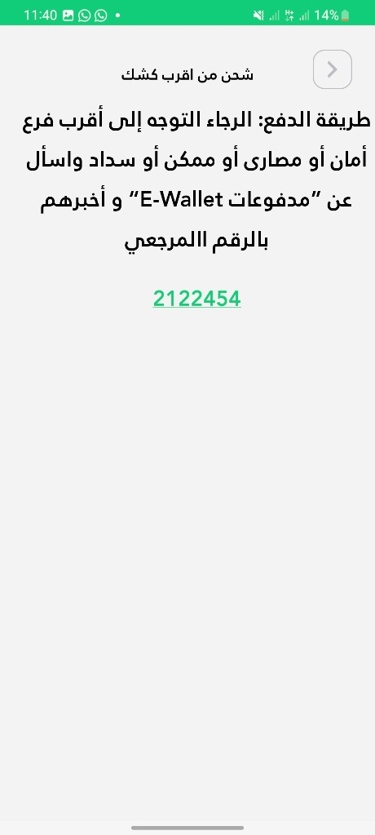
4
CHARGE BALANCE…
We have three way to charge the money:
Card of the bank
eWallet
booth

Slide 42

Thank you

